Slide 1
User Feedback for Interest Profiler

Slide 2
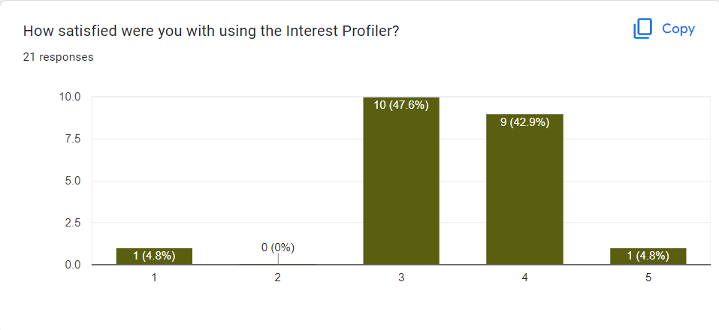
Overall Satisfaction of the Interest Profiler

Slide 3
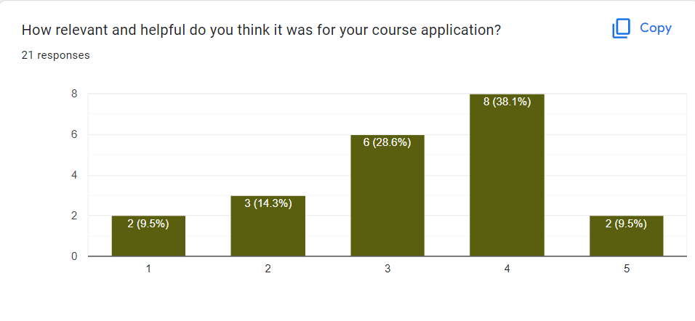
Relevance to Course Application

Slide 4
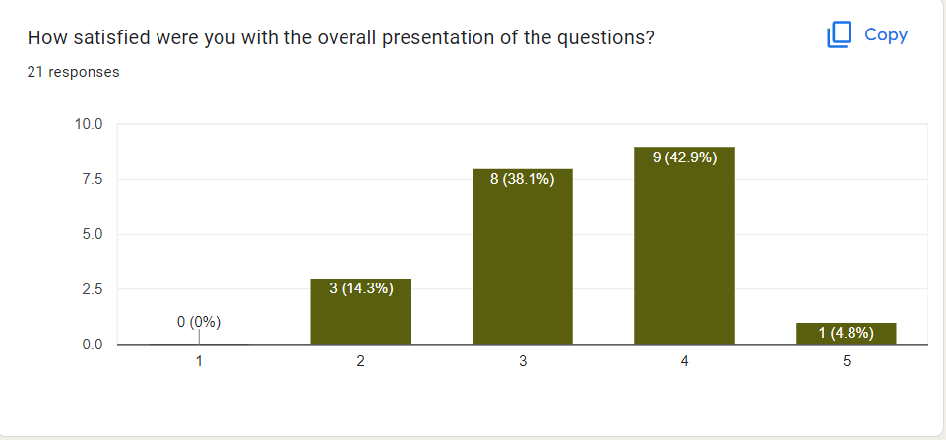
Satisfaction with overall presentation

Slide 5
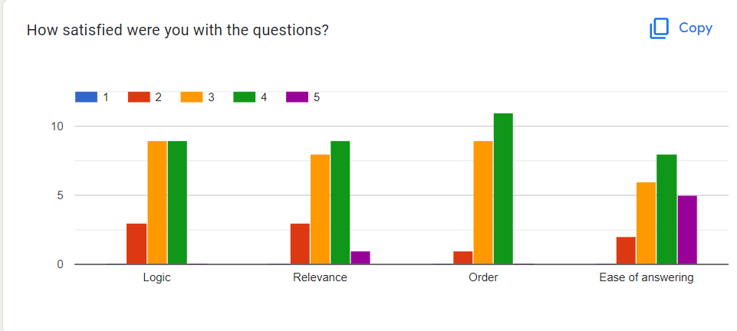
Satisfied with context of questions

Slide 6
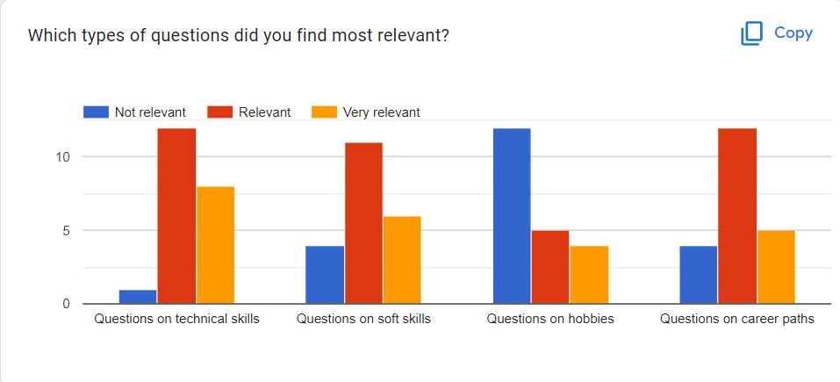
Relevance of questions

Slide 7
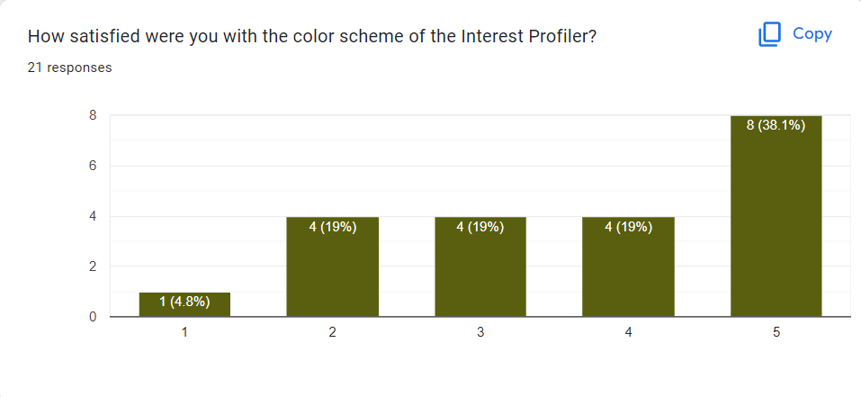
Satisfaction with color scheme

Slide 8
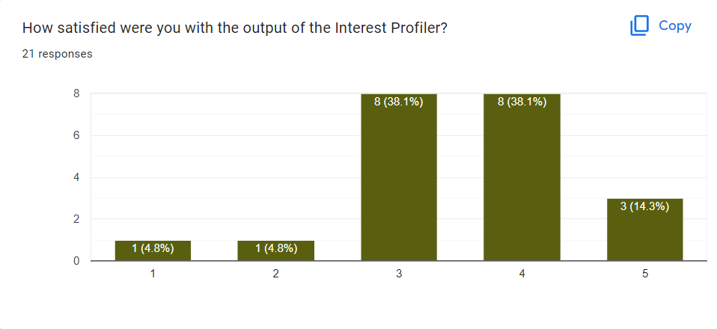
Satisfaction with output of Interest Profiler

Slide 9
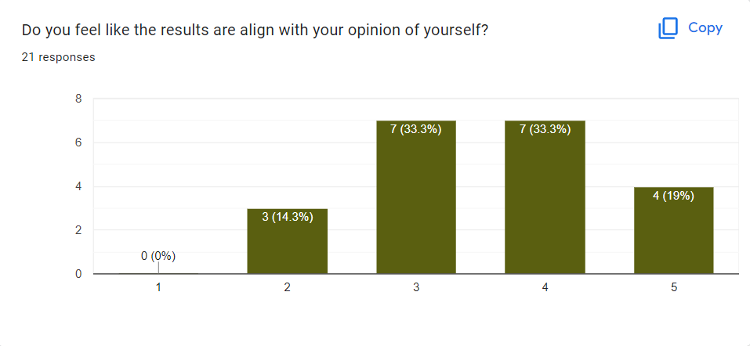
How does it align with your opinion of yourself?

Slide 10
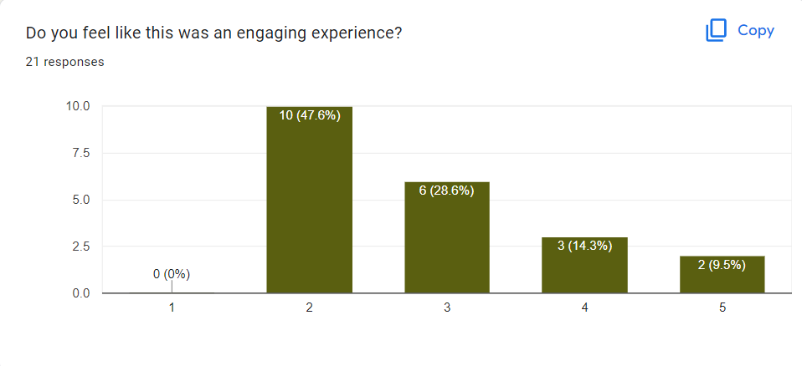
How engaging was it?

Slide 11
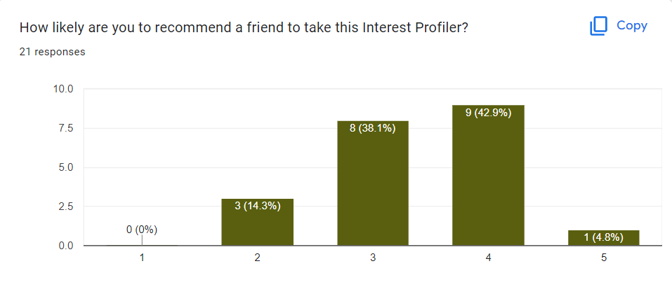
Recommend to a friend?

